Slide 1
Regression Analysis for Housing Prices in Ames, Iowa
By:
Eugene Khoo, Florian Combelles, Joanne Chong, Kenneth Goh, Tan Ming Jie

Slide 2
Agenda
Background
Problem Statement
Existing Prediction Model
Exploratory Data Analysis
Recommended Prediction Model
Conclusion and Recommendations

Slide 3
1.
Background
Who we are and what we do

Slide 4

Who we are
Reputable real estate agency established in 1990
Top agency in Ames, Iowa for achieving high sales volume in the last 20 years
Well-known for our proprietary Prop-Price Estimator ©
What it is: A prediction model that provides customers with best estimated price for their property

Slide 5
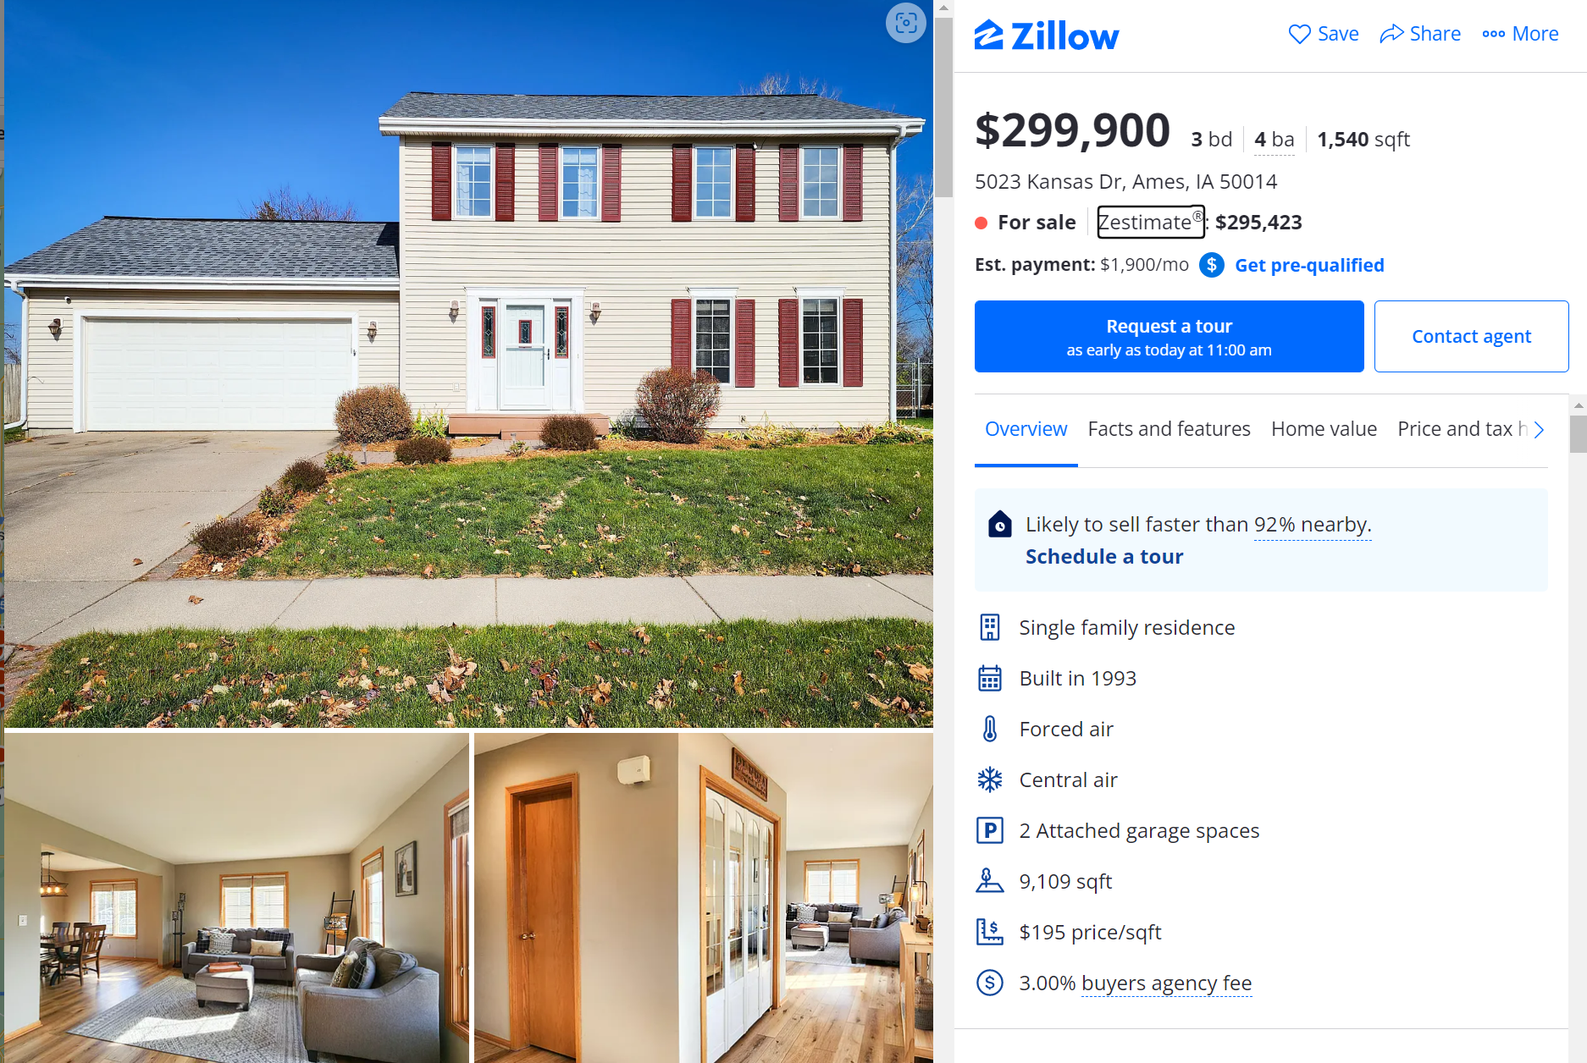
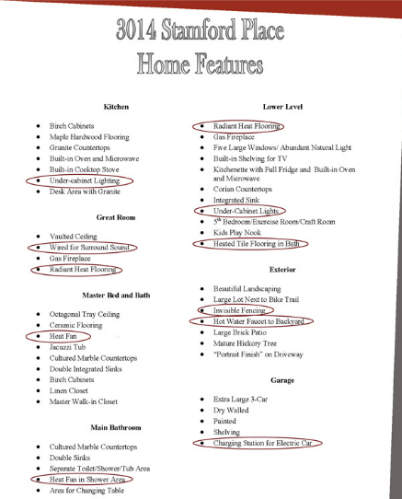
How does Prop-Price Estimator© work?
Paid buyer’s access
Data collection (For price estimation)
Ames Property Group
Ames Property Group
Home Feature Checklist

Slide 6
Importance of accurate price prediction
Strategic Pricing
Price estimation based on most sought-after property features
Maximise seller profit based on market demand
Listing Duration
Accurate price lead to increased interest and faster sales
Reduce listing management time
Decrease buyers’ bargaining power
Increase Engagement
Remain go-to agency for clients
Generate trust in our data-driven technology

Slide 7
2.
Problem Statement
The challenge at hand

Slide 8
Problem statement & objective
Increasingly competitive real estate market
Competitors offer higher-accuracy predictions
Shrinking market share
More customers looking for better predictions
Data scientists tasked to improve prediction accuracy
Enhance existing model or develop a new one
Model must beat top competitors

Slide 9
3.
Existing Prediction Model
The science behind the Prop-Price Estimator©

Slide 10
What we are currently using
Key Variables
Overall Material Quality
Living Area size
Neighborhood
1st Floor area
Garage Area
Basement Quality
Ridge Regression Model
Designed by external vendor
Deployed 2 years ago
Retrains with new data every two months

Slide 11
Current model performance
Highest coeff.
Overall Qual
$23107
Variability
84%
Margin of error
$29854

Slide 12
Why we need to upgrade our model
External Factors
Market competition
Rising number of competitors
Shift of focus toward prediction accuracy
Competitors error margin is 27.000$
Increasing customer demands
For more accurate selling price
Fast and simple prediction
Better recommendations to optimize property value

Slide 13
Why we need to upgrade our model
Internal Factors
Brand
Reputation as number 1 predictor in the market
Defend market leader position in the housing market
Client trust for over two generations
Cost management
Run time of model
Memory usage
Better recommendation support for our agents

Slide 14
4.
Exploratory Data Analysis
Deriving insights through new data set
Notes:
Initial analysis on general trends and correlations

Slide 15
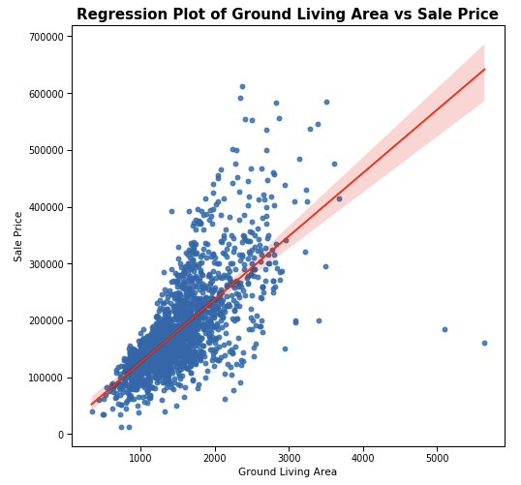
Ground Living Area positively correlated with Sale Price^(⅓)
The ground living area is 1,499 square feet
Most ground living area range from 1,129 to 1,728 square feet
Notes:
Ground living area has fewer outliers than lot area, given that large plots may not necessarily have large builtup areas; land is also abundant in the US → this could be an indicator that gr area is a stronger explanatory variable than total lot area

Slide 16
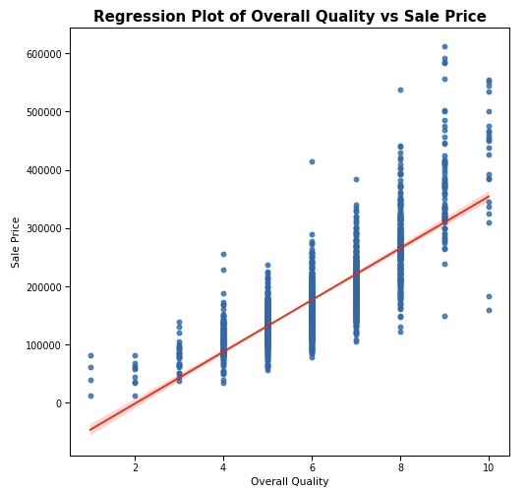
Overall Quality positively correlated with Sale Price
The average overall quality is 6.11
Average sale price for top, mid and low quality:
Rated 10: $417,397
Rated 6: $134,964
Rated 1: $28,725
Notes:
Next few features focus on the quality of the house

Slide 17
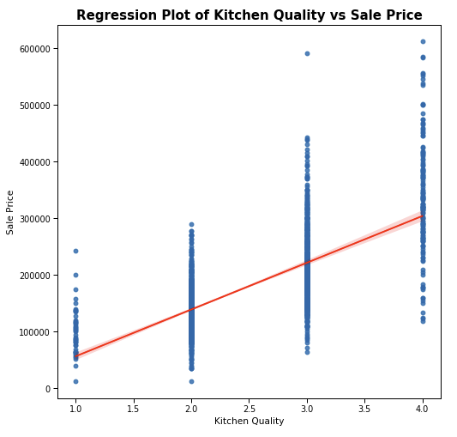
Kitchen Quality positively correlated with Sale Price
Ordinal values were scaled from 0-4
The average housing prices based on kitchen quality:
Excellent - $336,424
Good - $211,639
Typical/Average - $139,502
Fair - $101,335
Better-rated kitchen will result in higher price

Slide 18
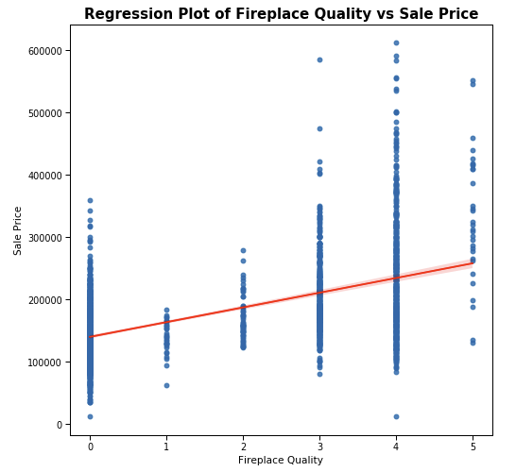
Fireplace Quality positively correlated with Sale Price
Ordinal values were scaled from 0-5
The average housing prices based on kitchen quality:
Excellent - $331,481
Good - $233,578
Typical/Average - $204,894
Fair - $170,287
Poor - $139,264
Better-rated fireplaces will result in higher price

Slide 19
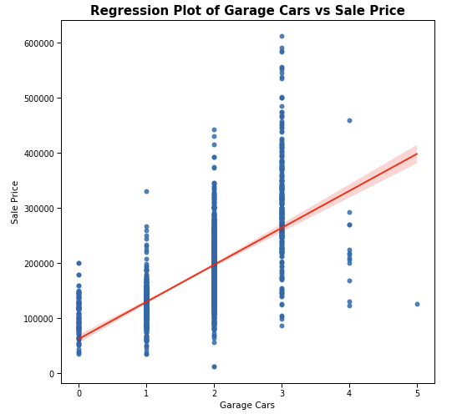
Garage Cars positively correlated with Sale Price
The average housing prices based on number of cars in a garage:
5 cars - $126,500
4 cars - $229,653
3 cars - $309,383
2 cars - $184,037
1 car - $126,916
No garage - $105,669
Being able to fit more cars in a garage will result in higher price

Slide 20
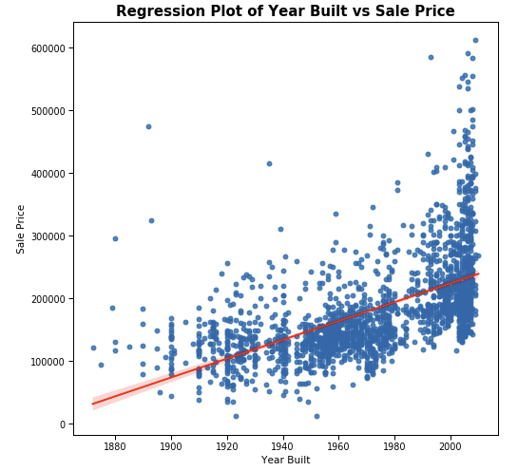
Newer built homes have higher Sales Prices
The average sale price of oldest homes:
1872 - $122,000
1875 - $94,000
1879 - $185,000
The average sale price of newer homes:
2010 - $267,916
2009 - $294,460
2008 - $326,057

Slide 21
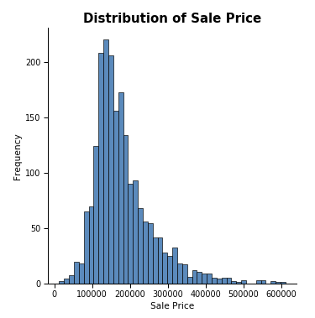
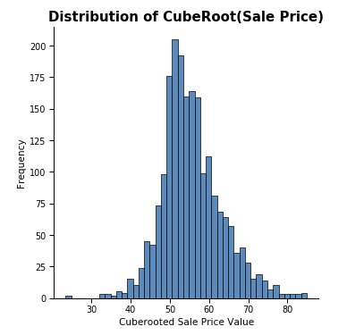
Applying cube root resolves right skewness of sale price distribution
The average sale price of a house in Ames, Iowa is $181,469
The smallest transaction was $79,259, while the largest price sold was $611,657

Slide 22
5.
Recommended Pricing Model
How we can regain our edge

Slide 23

Notes:
used to predict the values in a continuous range
Problem statement requires predictive capabilities - classification models (KNN) do not fit our requirements

Slide 24
Selected Features

Slide 25
Which features we want to use
DATASET
183 columns
REGULARIZATION
Lasso Regularisation
REGRESSION COEFFICIENT
Highest regression coefficient (E.g. Overall Quality & Overall Condition)
CORRELATION COEFFICIENT
Highest correlation coefficient (Selected features have average correlation coefficient of 0.5)
COLLINEARITY
Removing features with collinearity above 0.7
FEATURES
Final selection of 13 Features
Notes:
In order to explain our feature selection process, we can see it as a funneling process.
First we ran a model with 183 features, then we used lasso regularisation to penalise the regression coefficients of features that are not useful to the model. We used lasso regularisation as it has the ability to penalise the regression coefficients of useless features to 0.
Thereafter, we zoom in on features with high regression coefficients and at this step we also look at their correlation coefficients with housing prices. After picking out features with high regression and/or high correlation coefficient, we removed features with collinearity of above 0.7.
Finally, we end up with the 13 features we will be using in our final model.

Slide 26
Selected housing features
5
Ordinal
7
Numerical
1
Categorical
Overall Quality
Overall Condition
Kitchen Quality
Fireplace Quality
Basement Exposure
Year Built
Misc Value
Total Basement Area
No. of cars the garage can fit
Type 1 finished sf
Abv ground living area
Lot Area
Neighborhood (NorthRidge Heights)
Notes:
In order to make sense of these ordinal data we had to map the ranking to a scale of e.g 1 to 5
And for our categorical data, we had to one-hot encode it before it can be used

Slide 27
Evaluation of Models

Slide 28
How we’ll be measuring performance
High R2 Score
0 - 100%
Low Root Mean Squared Error
($) Value
Optimal No.of Features
Notes:
In order to evaluate the performance of our model, we will be using the
R2 score which is a value between 0% to 100%, and it evaluates how well the regression model explains observed data. For example, an r-squared of 60% reveals that 60% of the variability observed in the target variable is explained by the regression model
Therefore, we want R2 to be high.
Root Mean Squared Error is the square root average of the squared differences between actual and estimated values. For example a RMSE of 100k means on average, the model predicts a value 100k away from the actual value.
So, the lower the Root Mean Squared Error, the better.
Lastly, we would also want a model that is efficient and does not require too many features to function.

Slide 29
How our new model is faring
 | TRAINING SET R² SCORE (%) | TEST SET R² SCORE (%) | MARGIN OF ERROR ($) | # OF HOUSING FEATURES
Current Model | 83.22 | 83.75 | 29,854 | 6
Market Best | 84.12 | 85.57 | 27,000 | 17
New Model | 86.96 | 89.55 | 24,488 | 13
Notes:
3% increase in train score, 5% increase in test score and 5,000 lesser margin of error even if it requires 7 more features it is worth it.
We can also see all the other metrics of our new model were better than the market best.
New model beats all other models helping us regain competitive advantage

Slide 30
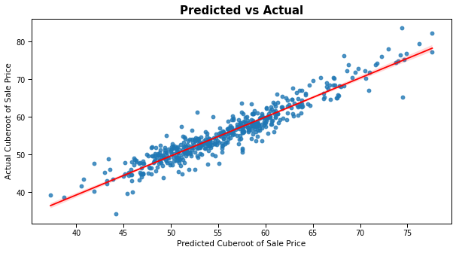
Predictive capabilities and reliability
Predicted values are within close proximity of actual values
Notes:
In order to tell how well our model actually performs, we need to look at the plot above.
The red line on the graph shows the actual values while the scatter points shows the predicted value.
Most importantly, we can see that majority of the predicted values falls within close proximity of the actual values.
Therefore we can conclude that the model is doing well in predicting housing prices.

Slide 31
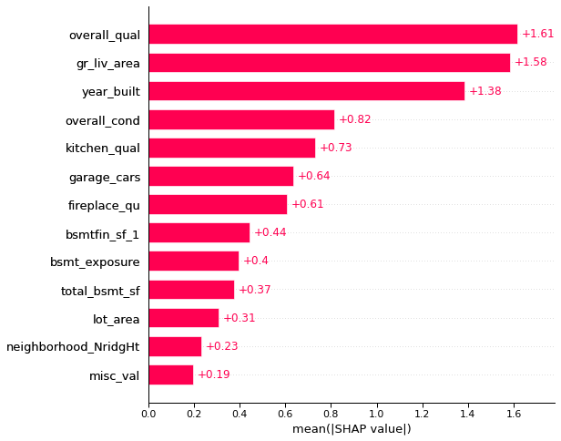
Influence of each feature on pricing
Bar Plot of Predictor Strength
Top 3 Predictors
Overall Quality
Above ground living area (Sq. ft.)
Year Built
Notes:
In order to better understand the significance of our features, we can refer to the bar plot above.
The SHAP value is calculated from an algorithm and it helps to increase the explainability of machine learning models.
And how we interpret the plot is that the feature with the greater mean absolute SHAP value has a greater impact on the model’s predictions.
Based on the bar plot, the top 3 features with the greatest impact is the overall quality, above ground living area (sq ft.) and the year built.

Slide 32
6.
Conclusion & Recommendations
Summing up our findings

Slide 33
In a nutshell
New Set of Variables
Overall quality Living area size Year built Overall condition Kitchen quality Capacity of garage Fireplace quality Basement size Basement exposure / access Lot area Neighborhood
Current Price Predictors
Overall Material Quality Living Area size Neighborhood 1st Floor area Garage Area Basement Quality
With our new prediction model
Black: Existing variables
Blue: New additions
Notes:
6 vs 13, more than double the no. features to get us our prices as accurate as possible
Increasingly important factors for buyers

Slide 34
Prediction model limitations
Sensitivity
Model sensitivity to outliers whenever there’s huge difference in features and/or price
Representation
Unrepresentative data from each neighbourhood
Overlaps
Overlapping characters and input for categorical variables, e.g. quality ratings “Average” and “Fair” sound similar
External Factors
Economical push that influence house prices such as the 2008 housing crisis in the US

Slide 35

Building more accurate prediction model
Further investigate features and ensure representation in data collection
Counsel homeowners to improve property’s market value through the top predictors
1
3
Ensure all home listings feature the top predictors
Better define characteristics for categorical variables
2
4

Slide 36
Thanks!
Any questions?
You can find us at:
intelligence@ameshousegrp.com

Slide 37
7.
Appendix

Slide 38
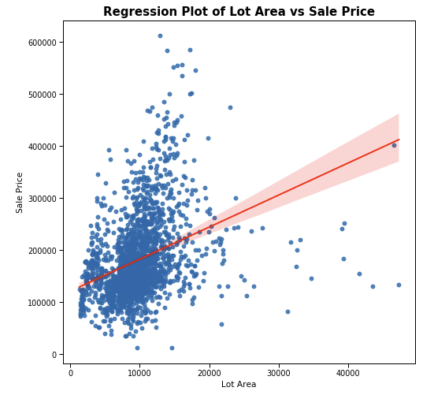
Lot Area positively correlated with Sale Price
The average lot area is 10,065 square feet
Most lot area range from 7,500 to 11,514 square feet
As lot size increase, the price increases as well

Slide 39
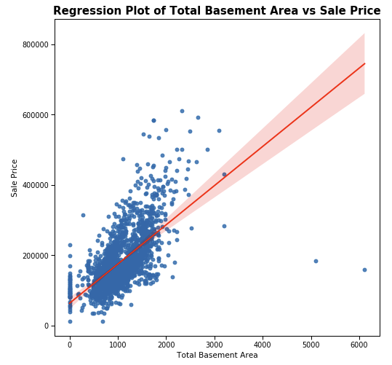
Total Basement Area increases with Sale Price
The average basement area is 1,057 square feet
Most basement area range from 793 to 1,318 square feet

